Slide 1
Introduction to java

Slide 2

Java features
Java is an object oriented programming language.
It has syntax similar to C and C++ hence simple
It is platform independent.
Robust in Construction
Used for development of Standalone and Distributed applications
.

Slide 3
History of Java
• The original name of Java was Oak, and it was developed as a part of the Green project at Sun Microsystems.
• Java was conceived by James Gosling, Patrick Naughton, Chris Warth, EdFrank, and Mike Sheridon at Sun Microsystems in 1991.
• Java was devised to have a programming language that is platform and architecture independent and also supports creation of distributed applications.

Slide 4
JDK- Java Development Kit
Compiler
Debugger
Doc development tool
Policy tool
JRE
Jar
Etc…

Slide 5
J V M
Java Virtual Machine (JVM) specification defines the JVM as an imaginary (virtual) machine that is implemented by emulating it in software on a real machine.
Code for the JVM is stored in .class files, each of which contains code for at most one public class.
This specification enables the Java software to be platform independent.

Slide 6
Compilation and execution of java program
Compilation:
javac <source file>
Eg: javac Sample.java
Execution:
java <class name> <cmd line args >
java Sample 23 34

Slide 7
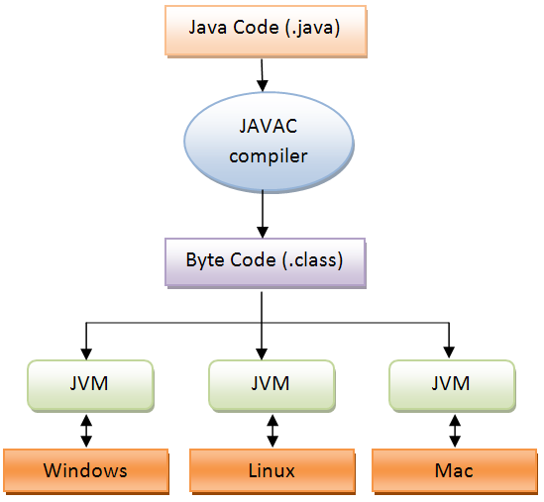

Slide 8
Overview of JVM
• Bytecode is a highly optimized set of instructions designed to be executed by the JVM.
• The key that allows Java to solve both the security and the portability problems is the output of a Java compiler, which is not an executable code rather it is the bytecode.
• The JVM is ported to different platforms to provide hardware and operating system independence, which is an environment independent of hardware and operating system
• JVM needs to be implemented for each platform.

Slide 9
J2SE Runtime Environment (JRE)
J2SE stands for Java2 Standard Edition.
• The JRE provides the libraries, JVM, Java Interpreter, and other components necessary to run applications written in Java.
• JRE is responsible for loading, verifying, and executing the bytecodes.
• The JDK includes the JRE.

Slide 10
Demo
public class HelloWorld{
public static void main(String args[]){
System.out.println("Hello, World!");
}
}
Public because it can be accessed anywhere in the context.
Main method is the start point of the program execution.
Main is static because it is accessed with the class but not with the object.
Void because it does not return any values.
Println is a method to print on the standard output.
System.out is the standard output stream object.
args is the array of string objects that are passed from the command line (can have any name)

Slide 11
Command line arguments
Java Sample 45 67 78
45 67 78 are stored in form of array of Strings.
String is a builtin class.
args[0] -- 45
args[1] -- 67
args[2] -- 78
args.length ----size of array which is 3
To get the numerical value..
Eg: int n=Integer.parseInt(args[0]).

Slide 12
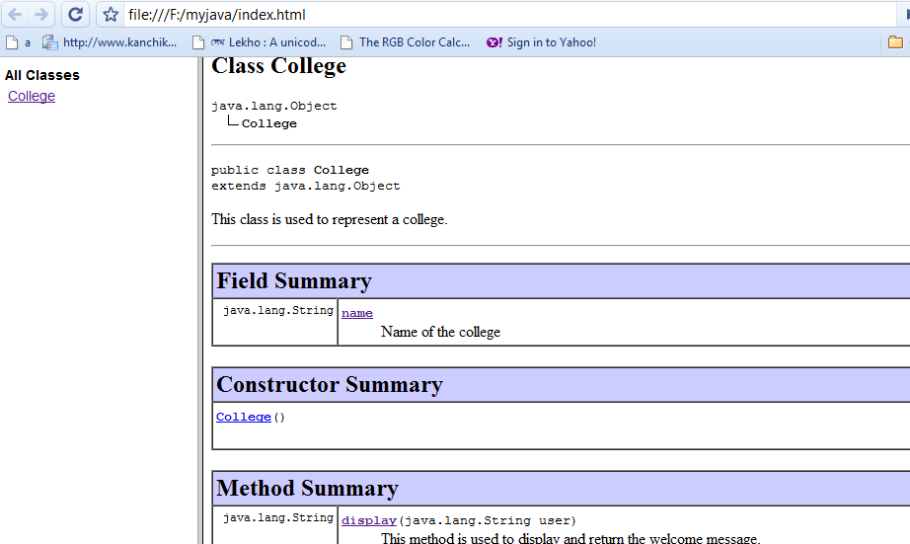
javadoc
Tool that is used to produce HTML pages by parsing through the documentation comment in java source code.
Produces documentation for public and protected classes/members.
Works on entire package or a single source file
Usage on source file
javadoc sourcefilename.java
javadoc College.java

Slide 13
Jar
Stands for Java Archive.
Collection of source and class files.
Can be executed from the command line. (java –jar <jar file name>)
Or can be reused in another application
Command to create a jar:
jar <options> <filename.jar> <location of the classes>

